Slide 1

NBSC
SMART CAPMUS

Slide 2
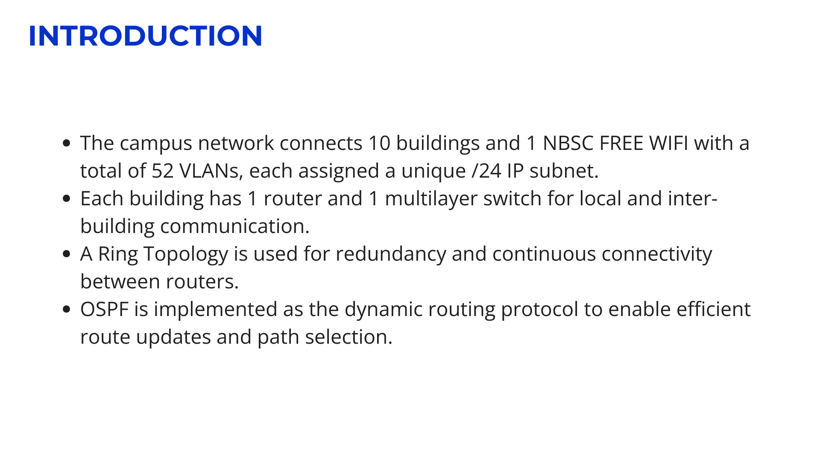
NBSC
SMART CAPMUS

Slide 3
DEVICE ROLES
DEVICE TYPE | ROLE IN THE NETWORK
ROUTER | Interconnects each building; runs OSPF for dynamic routing between VLANs/buildings
MULTILAYER SWITCH | Performs inter-VLAN routing within the building; connects to router and access switches
ACCESS SWITCHES | Connects end devices (PCs, printers, laptops) and Access Points within the VLANs
ACCESS POINTS (APS) | Provides wireless connectivity for mobile devices like smartphones and laptops
END DEVICES | Users' devices such as PCs, laptops, aircon, printer, smoke detector and smartphones that access network resources
Admin Building Configuration
6 VLANs (192.168.1.0 – 192.168.6.0)
Port Aggregation: Used between the Multilayer Switch and Access Switches
Purpose: Improves bandwidth and provides link redundancy
Access Points Password: 12345678
OSPF ALL AREA IS 1 AND NUMBER ID IS 1

Slide 4
VLAN AND IP DOCUMENTATION TABLE
ADMIN BUILDING
OFFICE NAME | VLAN NO. | VLAN NAME | ACCESS POINT | NETWORK IP | SUBNET MASK | GATEWAY
COA | 10 | COA | COA | 192.168.1.0 | 255.255.255.0 | 192.168.1.1
ACCOUNTING OFFICE | 20 | ACCOUNTING_OFFICE | ACCOUNTING OFFICE | 192.168.2.0 | 255.255.255.0 | 192.168.2.1
RECORDS AND ARCHIVAL | 30 | RECORDS_AND_ARCHIVAL | RECORDS AND ARCHIVAL | 192.168.3.0 | 255.255.255.0 | 192.168.3.1
CASHIER | 40 | CASHIER | CASHIER OFFICE | 192.168.4.0 | 255.255.255.0 | 192.168.4.1
BUDGET | 50 | BUDGET_OFFICE | BUDGET OFFICE | 192.168.5.0 | 255.255.255.0 | 192.168.5.1
ICTM | 60 | ICTMO | ICTM OFFICE | 192.168.6.0 | 255.255.255.0 | 192.168.6.1

Slide 5
INSTITUTE FOR TEACHER EDUCATION
OFFICE NAME | VLAN NO. | VLAN NAME | ACCESS POINT | NETWORK IP | SUBNET MASK | GATEWAY
ITE FACULTY 1 | 10 | ITE1 |  | 192.168.7.0 | 255.255.255.0 | 192.168.7.1
ITE FACULTY 2 | 20 | ITE2 | ITE Faculty | 192.168.8.0 | 255.255.255.0 | 192.168.8.1
INSTITUTE FOR COMPUTER STUDIES
OFFICE NAME | VLAN NO. | VLAN NAME | ACCESS POINT | NETWORK IP | SUBNET MASK | GATEWAY
ICS FACULTY | 10 | ICS | ICS Faculty | 192.168.9.0 | 255.255.255.0 | 192.168.9.1
LABORATORY 1 | 20 | LAB1 | Laboratory 1 | 192.168.10.0 | 255.255.255.0 | 192.168.10.1
LABORATORY 2 | 30 | LAB2 | Laboratory 2 | 192.168.11.0 | 255.255.255.0 | 192.168.11.1

Slide 6
REGISTRAR
OFFICE NAME | VLAN NO. | VLAN NAME | ACCESS POINT | NETWORK IP | SUBNET MASK | GATEWAY
REGISTRAR | 10 | REGISTRAR1 | Registrar | 192.168.12.0 | 255.255.255.0 | 192.168.12.1
 | 20 | REGISTRAR2 |  | 192.168.13.0 | 255.255.255.0 | 192.168.13.1
GENERAL EDUCATION CURRICULUM
OFFICE NAME | VLAN NO. | VLAN NAME | ACCESS POINT | NETWORK IP | SUBNET MASK | GATEWAY
GEC | 10 | GEC1 | GEC | 192.168.14.0 | 255.255.255.0 | 192.168.14.1
 | 20 | GEC2 |  | 192.168.15.0 | 255.255.255.0 | 192.168.15.1

Slide 7
INSTITUTE FOR BUSINESS MANAGEMENT
OFFICE NAME | VLAN NO. | VLAN NAME | ACCESS POINT | NETWORK IP | SUBNET MASK | GATEWAY
BA CONFERECE ROOM | 10 | BACR | BA Conference Room | 192.168.16.0 | 255.255.255.0 | 192.168.16.1
BA OFFICE 3 | 20 | BAO3 | BA Faculty Office 3 | 192.168.17.0 | 255.255.255.0 | 192.168.17.1
BA OFFICE 2 | 30 | BAO2 | BA Faculty Office 2 | 192.168.18.0 | 255.255.255.0 | 192.168.18.1
BA OFFICE 1 | 40 | BAO1 | BA Faculty Office 1 | 192.168.19.0 | 255.255.255.0 | 192.168.19.1
HEALTH BUILDING
OFFICE NAME | VLAN NO. | VLAN NAME | ACCESS POINT | NETWORK IP | SUBNET MASK | GATEWAY
HEALTH | 10 | HEALTH1 | Health Office | 192.168.20.0 | 255.255.255.0 | 192.168.20.1
 | 20 | HEALTH2 |  | 192.168.21.0 | 255.255.255.0 | 192.168.21.1

Slide 8
LIBRARY BUILDING
OFFICE NAME | VLAN NO. | VLAN NAME | ACCESS POINT | NETWORK IP | SUBNET MASK | GATEWAY
BOARD ROOM | 10 | BOARD_ROOM | Board Room | 192.168.22.0 | 255.255.255.0 | 192.168.22.1
OFFICE OF THE PRESIDENT | 20 | OP | OP | 192.168.23.0 | 255.255.255.0 | 192.168.23.1
OVPAA | 30 | OVPAA | OVPAA | 192.168.24.0 | 255.255.255.0 | 192.168.24.1
HRMO | 40 | HRMO | HRMO | 192.168.25.0 | 255.255.255.0 | 192.168.25.1
SPEECH LABORATORY | 50 | SPEECH_LAB | Speech Laboratory | 192.168.26.0 | 255.255.255.0 | 192.168.26.1
GAD | 60 | GAD | GAD Office | 192.168.27.0 | 255.255.255.0 | 192.168.27.1
Procurement Office | 70 | PROCUREMENT_OFFICE | Procurement Office | 192.168.28.0 | 255.255.255.0 | 192.168.28.1

Slide 9
LIBRARY BUILDING
OFFICE NAME | VLAN NO. | VLAN NAME | ACCESS POINT | NETWORK IP | SUBNET MASK | GATEWAY
LIBRARY COMPLEX | 80 | LIBRARY_COMPLEX | Library Complex | 192.168.29.0 | 255.255.255.0 | 192.168.29.1
VPUF | 90 | VPUF | VPUF | 192.168.30.0 | 255.255.255.0 | 192.168.30.1
MUSLIM PRAYER | 100 | MUSLIM_PRAYER | Muslim Prayer | 192.168.31.0 | 255.255.255.0 | 192.168.31.1
LIBRARY OFFICE | 110 | LIBRARY_OFFICE | Library Office | 192.168.32.0 | 255.255.255.0 | 192.168.32.1

Slide 10
STUDENT WELFARE AND DEVELOPMENT CENTER
OFFICE NAME | VLAN NO. | VLAN NAME | ACCESS POINT | NETWORK IP | SUBNET MASK | GATEWAY
NSTP Office | 10 | NSTP | NSTP Office | 192.168.33.0 | 255.255.255.0 | 192.168.33.1
CULTURE AND ARTS PATHFIT | 20 | PATHFIT | Culture and Arts Pathfit | 192.168.34.0 | 255.255.255.0 | 192.168.34.1
SASAFA OFFICE | 30 | SASAFA | SASAFA Office | 192.168.35.0 | 255.255.255.0 | 192.168.35.1
ATA OFFICE | 40 | ATAO | ATA Office | 192.168.36.0 | 255.255.255.0 | 192.168.36.1
EOINO | 50 | EOINO | EOINO | 192.168.37.0 | 255.255.255.0 | 192.168.37.1
IGP Office | 60 | IGP | IGP Office | 192.168.38.0 | 255.255.255.0 | 192.168.38.1
RESEARCH LABORATORY | 70 | RESEARCH_LAB | Research Laboratory | 192.168.39.0 | 255.255.255.0 | 192.168.39.1

Slide 11
LIBRARY BUILDING
OFFICE NAME | VLAN NO. | VLAN NAME | ACCESS POINT | NETWORK IP | SUBNET MASK | GATEWAY
GUIDANCE AND COUNSELING | 80 | GUIDANCE_AND_COUNSELING | Guidance and Counseling | 192.168.40.0 | 255.255.255.0 | 192.168.40.1
PREFECT OF DISCIPLINE | 90 | PREFECT_OF_DISCIPLINE | Prefect of discipline | 192.168.41.0 | 255.255.255.0 | 192.168.41.1
CSG OFFICE | 100 | CSG_OFFICE | CSG Office | 192.168.42.0 | 255.255.255.0 | 192.168.42.1
SAS | 110 | SAS | SAS | 192.168.43.0 | 255.255.255.0 | 192.168.43.1
PLANNING & DEVELOPMENT OFFICE | 120 | PLANNING_AND_DEVELOPMENT_OFFICE | Planning & Development Office | 192.168.44.0 | 255.255.255.0 | 192.168.44.1
Quality Assurance | 130 | QUALITY_ASSURANCE | Quality Assurance | 192.168.45.0 | 255.255.255.0 | 192.168.45.1
PAICIDO | 140 | PAICIDO | PAICIDO | 192.168.46.0 | 255.255.255.0 | 192.168.46.1

Slide 12
LIBRARY BUILDING
OFFICE NAME | VLAN NO. | VLAN NAME | ACCESS POINT | NETWORK IP | SUBNET MASK | GATEWAY
GENERAL SERVICES UNIT | 150 | GENERAL_SERVICE_UNIT | General Services Unit | 192.168.47.0 | 255.255.255.0 | 192.168.67.1
ROTC HEADQUARTERS | 160 | ROTC | ROTC Headquarters | 192.168.48.0 | 255.255.255.0 | 192.168.48.1
SUPPLY BUILDING
OFFICE NAME | VLAN NO. | VLAN NAME | ACCESS POINT | NETWORK IP | SUBNET MASK | GATEWAY
SUPPLY | 10 | SUPPLY1 |  | 192.168.49.0 | 255.255.255.0 | 192.168.49.1
 | 20 | SUPPLY2 | Supply Office | 192.168.50.0 | 255.255.255.0 | 192.168.50.1

Slide 13
FREE WIFI
OFFICE NAME | VLAN NO. | VLAN NAME | ACCESS POINT | NETWORK IP | SUBNET MASK | GATEWAY
 | 10 | NBSC | NBSC FREE WIFI | 192.168.51.0 | 255.255.255.0 | 192.168.51.1
 | 20 | STUDENTS | NBSC STUDENTS | 192.168.52.0 | 255.255.255.0 | 192.168.52.1

Slide 14
INTER-ROUTER OSPF LINK IP ASSIGNMENT TABLE
LINK | NETWORK ID | SUBNET MASK | IP ON ROUTER A | IP ON ROUTER B
ADMIN—ITE | 10.10.10.0 | 255.255.255.0 | 10.10.10.1 | 10.10.10.2
ITE—ICS | 20.20.20.0 | 255.255.255.0 | 20.20.20.1 | 20.20.20.2
ICS—REGISTRAR | 30.30.30.0 | 255.255.255.0 | 30.30.30.1 | 30.30.30.2
REGISTRAR—GEC | 40.40.40.0 | 255.255.255.0 | 40.40.40.1 | 40.40.40.2
GEC—IBM | 50.50.50.0 | 255.255.255.0 | 50.50.50.1 | 50.50.50.2
IBM—HEALTH OFFICE | 60.60.60.0 | 255.255.255.0 | 60.60.60.1 | 60.60.60.2
HEALTH OFFICE—LIBRARY | 70.70.70.0 | 255.255.255.0 | 70.70.70.1 | 70.70.70.1

Slide 15
INTER-ROUTER OSPF LINK IP ASSIGNMENT TABLE
LINK | NETWORK ID | SUBNET MASK | IP ON ROUTER A | IP ON ROUTER B
LIBRARY—SWDC | 80.80.80.0 | 255.255.255.0 | 80.80.80.1 | 80.80.80.2
SWDC—SUPPLY OFFICE | 90.90.90.0 | 255.255.255.0 | 90.90.90.1 | 90.90.90.2
SUPPLY OFFICE—FREE WIFI | 100.100.100.0 | 255.255.255.0 | 100.100.100.1 | 100.100.100.2
FREE WIFI—ADMIN | 110.110.110.0 | 255.255.255.0 | 110.110.110.1 | 110.110.110.2

Slide 16
RING TOPOLOGY
R1
R1
R1
R1
R1
R1
R1
R1
R1
R1
R1

